Slide 1
DISABLED ACCESSIBILE CITIES
CASA0003 – Group Mini Project: Digital Visualization
Group 9
Yafei Ye,
Yuhong Sang,
Bogdan Rugina,
Arun Srinivasan

Slide 2
Disability in Urban cities
One billion of the world’s population have a disability, with an estimated 80% of people with disabilities living in developing countries
UN have suggested that by 2050, it is expected that about 6.25 billion people, 15 percent of whom are persons with disabilities, will be living in urban cities.
It is truly “invisible” whether countries and its urban landscape are fully capable and inclusive to handle this surge which will allow the disabled to live a life no different than able-bodied people.

Slide 3
What do we aim to achieve?
A recent study shows that a person with disability have to travel 49% longer than a able-bodied person in London – We magnify into disabled transportation accessibility across the UK.
A recent survey conducted by YouGov shows one in four UK employers would not hire someone with a disability – We go into the disability employment statistics published by the Office for National Statistics and visualize the journey of Disabled Employment across years in the various boroughs of London.
Last year, the Minister for Disabled People in UK said that the food & drink industry could be missing out on the ‘Purple Pound’ which is worth an estimated £249bn a year. We try to visualise the wheelchair accessible businesses in London.
London has recently set aside £300m to improve its inclusiveness of the disabled and has vowed to implement new measures by 2030 – We look into Manchester City’s journey into transforming the city and the policies which could be used across UK.

Slide 4
Gap between accessibility & disability in Great Britain
Yuhong Sang

Slide 5
Objective
Accessibility - accessible rail stations / total rail stations
Disability - Disabled Population in a local authority
Aim - To Analyse whether the construction of the accessible facilities in train stations match the distribution of the disabled population.
How to use this in a html page?
What can this html page tell the users?

Slide 6
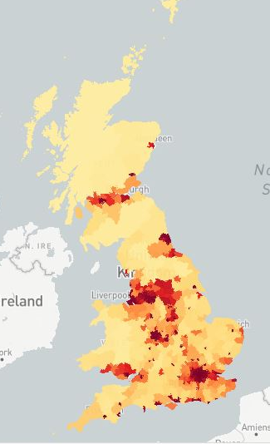
Overall situation - based on disabled population density
Disabled population / Area of local authority
Major economic cities have greater density

Slide 7
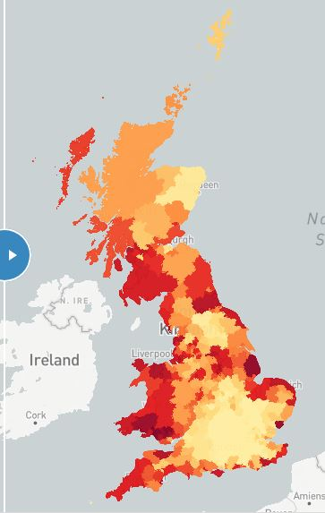
Overall situation - based on disabled population proportion
Disabled population / Total population of local authority
Coastal cities have larger proportion

Slide 8
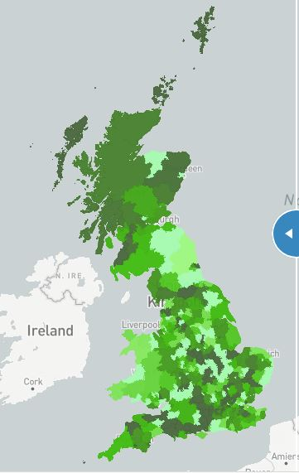
Overall situation - based on disabled population proportion
Disabled population / Total population of local authority
Coastal cities have larger proportion
More in line with the accessible station proportion
Reflects the proportion of demand

Slide 9
Overall situation - based on disabled population density
Overall situation - based on disabled population density
Disabled population / Area of local authority
Major economic cities have greater density
Less consistent with the accessible station proportion
Why? - More specific Analysis.

Slide 10
Comparison in specific region or city
Greater London
Disabled population density is completely different from the proportion
Liverpool & Knowsley
Disabled population density and proportion are both relatively high
Adjacent to each other with similar areas and situations
Summary - A small gap between accessibility and disability, but they are generally matched.

Slide 11
London Disabled Employment
Arun Srinivasan

Slide 12
What is this objective of this visualization?
This visualization tries to highlight the gap in employment and unemployment rates between the disabled and able-bodied
Go over 13 years of data to see how the employment of disabled has changed in London
Provide a level of interactivity to the viewer that allows them to navigate across different boroughs across years

Slide 13
Challenges faced & Decisions made
Data
Data for the City of London Borough missing through the dataset.
Design
Even though numerical data was present, a decision was made to go with the % statistic as it was more easily interpretable.
Alternatives like D3 and plot.ly were considered for the chart visualization but decided to go with chart.js which seemed quite popular and was easy to implement.
Data was missing for the year 2013 due to changes in the health questions on the Annual Population Survey. Overcome by taking a mean of the years 2012 and 2014.
Disabled Unemployment data was missing for a few years in certain boroughs. Overcome by calculating the mean of the previous and following years.
Implementation
Since there were 2 user provided inputs (year slider and radio controls), handling the on-change events in JS were a little tricky.
A 2 column design was pondered but eventually went with an overlay design where all the objects in the visualization overlaid the map layer.
Hover action over the map and the rendering of the chart and statistics are coherent to an extent. However moving the mouse away from the map makes the chart disappear.
All JS packages are imported using CDN’s and it will require an active internet connection to work.
This webpage does not automatically adjust itself to different resolutions of the different screens it is viewed in.

Slide 14
Wheelchair accessible businesses in london
Yafei Ye

Slide 15
Objectives
Draw a map of the current wheelchair accessible businesses in London, so that the distribution can be seen straightforwardly;
Create a search function that people can find their positions and read detailed information about businesses around easily;
Investigate the distribution of wheelchair accessible businesses in each borough of London to analyse the spatial unfairness;
Calculate the percentage that wheelchair accessible businesses take up in all businesses in London to show the emphasis degree of business wheelchair accessibility.

Slide 16
Methods
Data acquisition and processing
Python: retrieve and clean data from Yelp API
Excel: merge categories
ArcGIS: join business points with boroughs
Mapbox Tilesets
Interactive Website Construction
Show and hide layers
Hover highlight effect
Search bar
Popup
Charts

Slide 17
RESULTS
Distribution Regulations
Most wheelchair accessible businesses are in the inner London – spatial unfairness;
Restaurants, Food, Shopping, Night Life, Beauty & Health: clustering in the West End and the East End of London;
Travel & Hotels: in the boundary of high-density area of restaurants and shops & close to tube lines;
Leisure: more randomly;
Local Services: Oxford Street;
Functions
Search for the most satisfied business by using search bar and the popup of businesses;
Statistics
Accurate numbers of businesses in a borough can been shown in popup both in the map or charts;
All kinds of businesses in London which are accessible for wheelchair take up less than 5% in total number of businesses;
Conclusion
The current wheelchair accessible businesses situation in London is unsatisfactory according to Yelp data;
It may be caused by the bias of data source as Yelp only returns businesses with reviews;
Some businesses may be labelled incorrectly

Slide 18
Greater Manchester – vision 2040
Bogdan Rugina

Slide 19
What can we conclude?
Our contribution represents a guide about accessibility state of art and plans in the UK context.
Total percentage of disabled people is growing in UK, in the following decades elderly people especially will require even more resources at city and national level
Our invisible city (disabled people) require some future improvements in terms of infrastructure
The data visualized show that accessibility plans should be an integral part of any transport strategy

Slide 20

Questions & Discussion

